Slide 1
Part 3
BRINGING CULTURAL BURNING BACK ONTO COUNTRY

Slide 2
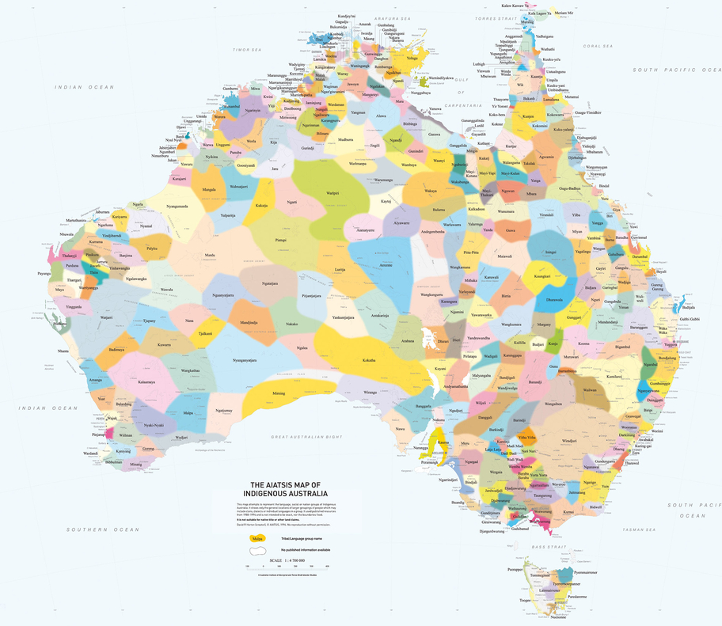

Is Aboriginal cultural burning happening in Victoria?
Notes:
Ask the students if they think Aboriginal cultural burning is happening in Victoria. Facilitate a short discussion to elicit what they already know.

Slide 3
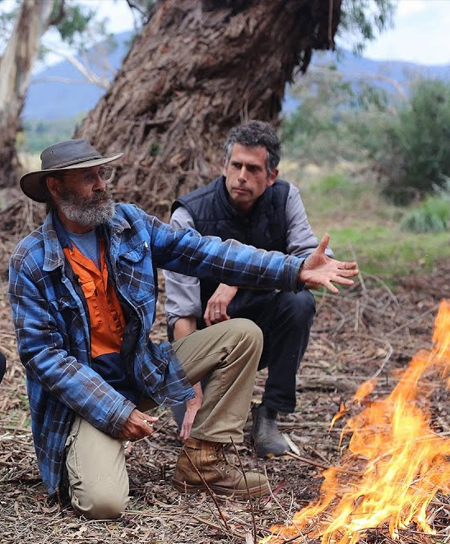
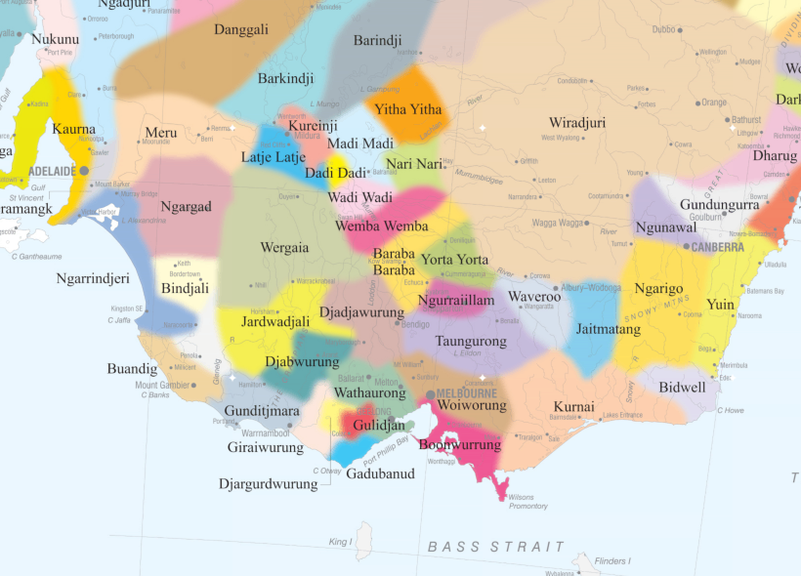
Aboriginal cultural burning on Wurundjeri Country
Uncle Dave Wandin is a Wurundjeri elder. He is bringing cultural burning back to Wurundjeri Country.
Notes:
Tell the students that Aboriginal cultural burning is happening on Wurundjeri Country. Point out Wurundjeri Country on the Map. Introduce Wunrundjeri elder, Uncle Dave Wandin (pictured in check shirt and hat).
Tell the students they are going to watch a video about one of Uncle Dave’s cultural burns on Wurundjeri Country.
NB: The Wurundjeri people are an Aboriginal people of the Woiwurrung language group. For a good explanation of the difference between Wurundjeri and Woiwurrung, watch this video by Wurundjeri woman, Dr Mandy Nicholson https://www.youtube.com/watch?v=HIl8ifFnG7c

Slide 4
What burning question do you have?
See-Hear-Feel-Wonder
WHAT DID YOU SEE?
WHAT DID YOU HEAR?
WHAT DID YOU FEEL?
WHAT DID YOU WONDER?
Notes:
Before playing the video, put the students in groups of 4 or 5. Give each student a piece of A4 paper. Tell the students to fold it into four and then write in the headings as displayed on the slide.
Before playing the video, tell the students that at particular points the video will be paused and they will silently record whatever comes to mind.

Slide 5
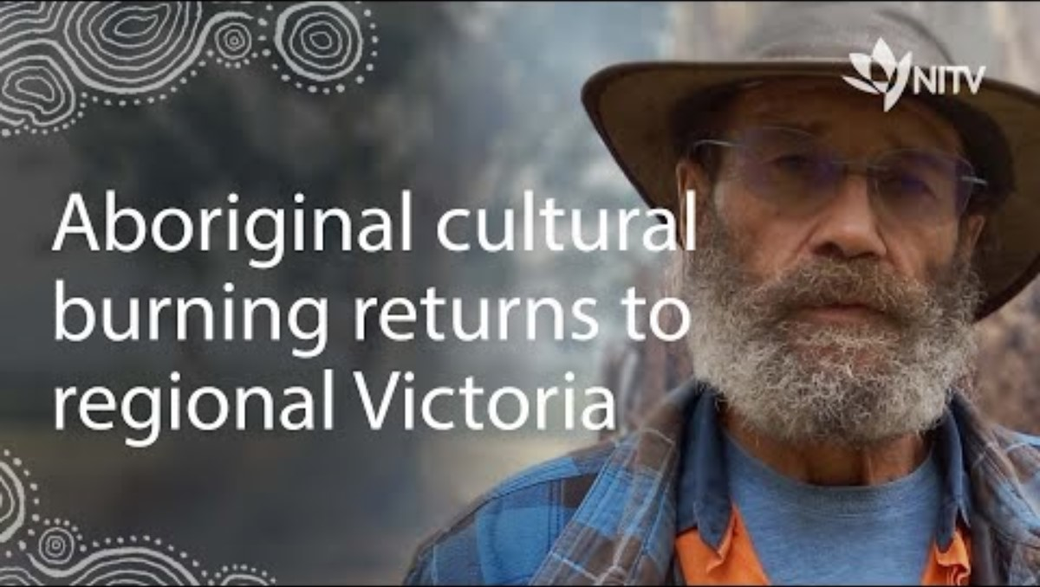
Notes:
NB: The video is embedded in the slide. Link to video: https://www.youtube.com/watch?v=LwL_-JWCn-8
Play the video in four parts. Recommended time stamps are provided below. At the end of each part, give the students a couple of minutes to silently record their responses in each quadrant on their sheet. After a couple of minutes, give the students some time to discuss what they recorded with the other members of their group. They can add any additional information they see as important in the relevant quadrant.
Recommended timestamps
Part 1 00:00 - 01:35
Part 2 01:35 – 03:27
Part 3 03.27 – 04:53
Part 4 04:53 – 05:58

Slide 6


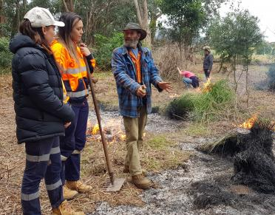
Learning from Uncle Dave Wandin
Create a text about what you have learned from Uncle Dave.
You can use pen and paper, voice recording, video, drawing, PowerPoint, poster, or any combination of these.
Use the information you recorded on your See-Hear-Feel-Wonder worksheet for inspiration and ideas.
Notes:
Think-Pair-Share: Give the students a minute or two to think about the most important things they have learned about Aboriginal Cultural Burning from Uncle Dave. The students can then discuss their ideas with a partner. Invite the students to share their partner’s thoughts and record them on the board. Highlight any key themes as they emerge e.g. the benefits of cultural burning (environmental, social, cultural, psychological, spiritual), when to burn, how to burn etc.
Talk through the task instructions on the slide. Remind the students that they can use their See-Hear-Feel-Wonder worksheet for inspiration and ideas.

